Slide 1


Patient-centered contraceptive counseling

Slide 2

Overview
  Bias in family planning provision
  Reproductive Justice Framework
  Contraceptive Counseling: a patient-centered approach

Slide 3

Do all patients have the same options?
Notes:
We have already talked about how social oppression and discrimination can limit a patient’s choices in when they have and raise their children.
As individual health care providers, we may also contribute to this inequality through our unconscious (or conscious) bias towards patients, particularly regarding contraception. Lets explore that now.

Slide 4
Bias in family planning
Low-income women of color more likely to report being advised to limit their childbearing than are middle-class white women
Black women are more likely than white women to report having been pressured by a clinician to use contraception
In a survey of black women, 28% reported being pressured to start one type of method when they preferred another
Providers are more likely to agree to sterilize minority and poor women than white middle or upper class women
Downing: Am J Public Health, 2007
Becker: Perspect Sex Reprod Health, 2008
Thorburn: Women Health, 2005
Jackson, Unpublished data
Notes:
Multiple studies have documented the ways in which the sexual and reproductive health of marginalized patients has been compromised by racism, discrimination, and oppression. Many policies and practices actively undermine and devalue the childbearing of certain groups, while effectively forcing childbearing onto others.
It is important for us as providers to be aware of our own implicit biases and how these biases influence the way we might counsel our patients about contraception. Likewise, as teachers we need to be vigilant to highlight these possible biases and prejudices among our students as well.

Slide 5
Measuring bias in counseling
Research question: Are there biases in counseling about the IUD?
Methods:
  524 health care providers at national conferences
  Shown 1 of 18 videos of standardized patients with varying presentations of race and SES and gynecologic risk factors
  Providers indicated whether they would recommend levonorgestrel intrauterine contraception (IUC)
  Analysis done on 173 responses to the patients with no risk factors
Dehlendorf: Am J Obstet Gynecol: 2010
Notes:
I wanted to highlight one recent study that attempted to qualify how provider bias affected contraceptive counseling, particularly looking at the levonorgestrel IUD. The researcher created standardized patient videos with varying presentations of race, SES, and gynecologic risk factors and presented them to a group of OB/GYN and Family Medicine doctors. The providers were asked to indicate if they would recommend a levonorgestrel IUD to the patient in the video. They surveyed 524 providers and analyzed the results of the 173 respondents who saw patients with had NO RISK factors

Slide 6



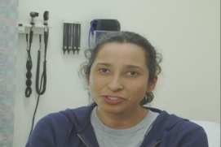


The “Patients”
Notes:
The patient with low socioeconomic status was portrayed as a housekeeper studying for her GED and the patient with high socioeconomic status as a recent business school graduate working as a bank manager. The providers were told that the patient was 27 years old, had normal blood pressure, and had recently had a negative test for Gonorrhea and Chlamydia and a normal Pap test. Each patient indicated that she was in a monogamous relationship and that she did not want to become pregnant for at least a few years.

Slide 7

Recommendations differ by patient race and class
Providers were more likely to recommend IUD to:
  High SES >> Low SES
  Black women >> white women
  Low SES women of color >> Low SES white women
No racial/ethnic difference in recommendations among high SES women
Providers’ implicit biases impacted the way that they provide contraceptive counseling
Dehlendorf: Am J Obstet Gynecol: 2010
Notes:
The results showed that providers were more likely to recommend the IUD to patients with higher SES than to patients with lower SES. It also revealed that providers were more likely to recommend the IUD to black patients compared to white patients. However when both race and SES were considered the recommendations were higher for women of color who had low SES compared to white women with low SES.
These results suggest that there is some component of racial and SES bias which is influencing the providers willingness to recommend the IUD.
Of course all of us have biases which influence how we perceive others. The key here is for us to become aware of our biases and to uncover whether they are affecting our recommendations.

Slide 8
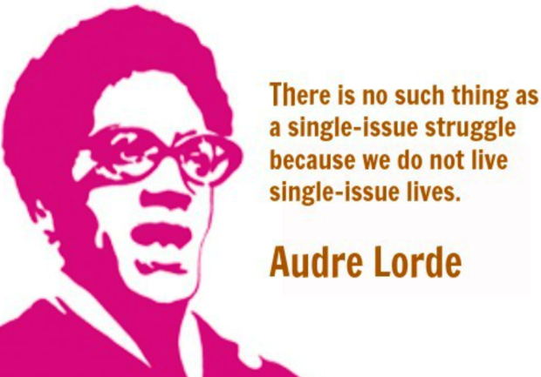
Notes:
Since we know that issues such as race and class do have profound impacts on our lives, we have to ask ourselves how we can become aware of these forces and try to meet patients where they are at and provide optimal reproductive health care?
Audre Lorde was an American writer, feminist, and civil rights activist. She is often quoted, saying: There is no such thing as a single-issue struggle because we do not live single-issue lives.
We cannot talk about reproductive health care without understanding the larger world in which we all exist. So lets explore how these various forces can influence our patients decisions while still allowing them to have autonomy in their reproductive health choices.

Slide 9
Intersectionality
Notes:
Kimberlé Crenshaw coined the term “intersectionality” 30 years ago to describe how race, class, gender, and other individual characteristics “intersect” with one another and to explain how people experience discrimination differently depending on their overlapping identities
An intersectional framework, or an approach that allows us to consider all of the various social and political forces that act on individuals and communities, can help us to ensure that, as we work w patients, we aren’t overlooking the unique challenges facing people with not just one but *multiple* oppressions.

Slide 10
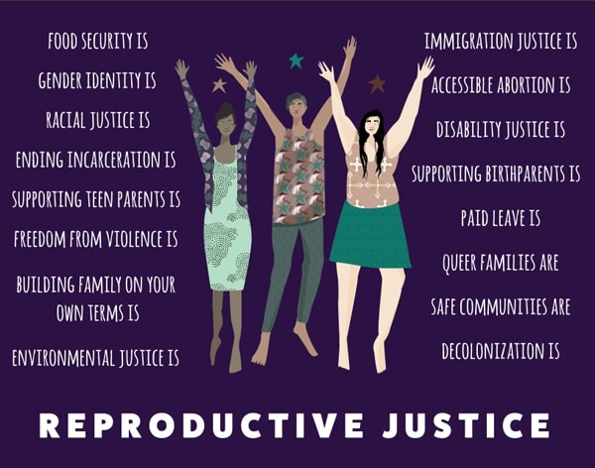
Reproductive Justice Framework
Notes:
Which brings us back to the Reproductive Justice Framework.
As an organization that works to expand access to reproductive health services like contraception, it is very important that we do so from a place informed by the reproductive justice framework in order to eliminate the reproductive conscious and unconscious bias that can be present in these conversations

Slide 11

  Reproductive Justice
  Addresses the influence of social, economic, and political inequalities on women’s reproductive choices
  The right not to have a child
  The right to have a child
  The right to parent children in safe and healthy environments
  The right to maintain personal bodily autonomy
Notes:
The foundational principals of Reproductive justice is the belief that every person has:
1) THE RIGHT NOT TO HAVE A CHILD
2) THE RIGHT TO HAVE A CHILD
3) THE RIGHT TO PARENT CHILDREN IN SAFE AND HEALTHY ENVIRONMENTS
4) THE RIGHT TO MAINTAIN PERSONAL BODILY AUTONOMY

Slide 12

What about Teen Pregnancy?
Social inequality, especially poverty, is a broad structural issue, not the result of single repro choice
Bias exists towards one particular life trajectory, which often influences our counseling
Notes:
While we all agree we should challenge our biases around who should be and stay pregnant, one group that is consistently viewed as being unfit for parenting are teenagers. We focus so much energy on preventing teen pregnancy based on the assumption that teen pregnancy leads to poverty and poor outcomes for their families.
However poverty is much more structural and tied to inequity in wealth, access to good jobs, home ownership, transportation, and quality of schools in a community. The idea that pregnancy and parenting alone can have such an impact on poverty in the context of all of these other structural factors is highly debatable.
There is also an implicit prioritization by many providers and institutions that patients should complete school, establish a secure career and romantic partnership, and only then have children. We should remember that there are many different ways to accomplish all the things one wants to do in life and there is no “correct” order to do them.

Slide 13
Case discussion
A patient is here for a post-partum visit. The patient is 22, African-American, and has 1 other child at home. She lives with her mom and is currently working at a fast-food restaurant.
The med student who started the visit says that the patient doesn’t want to take any birth control right now because she is worried about hormones.
Notes:
5 minutes discussion
Things to further bring up if not discussed in discussion:
-

Slide 14
Case discussion
The med student is concerned that if the patient doesn’t use birth control, “she will have another unintended pregnancy.”
Reflect on the experience of this patient. What judgements or presumptions are being made about the patient’s intentions or circumstances?
How might the RJ framework be used to craft a response to this medical student?
Notes:
5 minutes discussion
This med student leapt beyond the patients priorities and goals and focused instead on the health risks of short interval pregnancies while making paternalistic assumptions about this patient’s life and choices

Slide 15
How do we talk about contraception?
Listing all methods
Promoting certain methods
Notes:
As health professionals we have been taught present contraception in usually one of two ways – either a consumerist model where we put all the options out to the patient and simply ask “what do you want” or we use some form of directive counseling to persuade patients to choose a method preferred by the health care system or provider.
This creates a tension between providing access and paternalistic or coercive methods of communication

Slide 16
Limitations
Listing all Methods
Providing “objective” information
But often not eliciting a patient’s reproductive health goals and preferences
Promoting certain methods
Tiered effectiveness or motivational interviewing
Rooted in healthcare provider’s preferences or assumptions about patient priorities
Notes:
One example is the relatively recent change in the promotion of long-acting reversible contraceptives, like IUDs and implants, often known as LARC. Until recently, LARC methods were considered a last-resort option, only if other methods had failed. With new data, we were able to demonstrate that the previous restrictions on eligibility for these devices, such as already having a healthy child, and being an adult in a monogamous relationship, are no longer valid. Providers all rushed to make sure patients were aware that these highly effective options existed!
However, in our excitement about having this new option, we must recognize that efficacy might not be the most important issue for patients deciding about contraception. Remembering this, we must be careful not to assume that one method is the best for all paitents
Some studies done by colleagues showed that physicians felt they had failed in their work if a patient did not leave the office with a LARC device and were reluctant to remove a device if the patient requested it.
On the other hand, we must continue to address systemic barriers that make LARC and other methods inaccessible to patients because of cost, insurance issues, outdated eligibility requirements, and lack of trained clinicians.
We must maximize access to care while maintaining patient autonomy. As individuals, we need to know as much as we can about all contraceptive methods and present them in a patient-centered way. Contraception options discussions with our patients should be without judgment or assumption about which method we think is best for them.

Slide 17

Patient-Centered
Contraceptive Counseling
Full range of options
Patient preferences
Maximize access
Notes:
So lets talk about how we can approach contraceptive counseling in a patient-centered way using a reproductive justice framework
Individuals who have themselves experienced or who have heard stories about the very real history of reproductive coercion and oppression may not trust health professionals..
These stories from from friends and family about experiences of reproductive coercion and oppression might effect the way our patients can hear updated medical information. and we need to respect that.
The first question I ask patients is if they want to discuss contractive options with me today…some do, some say they want to but not right now, and some don’t. I think that respecting patients decisions leads to a better long-term relationship of trust…
But when the patient does want to talk about contraception, we can get started.

Slide 18
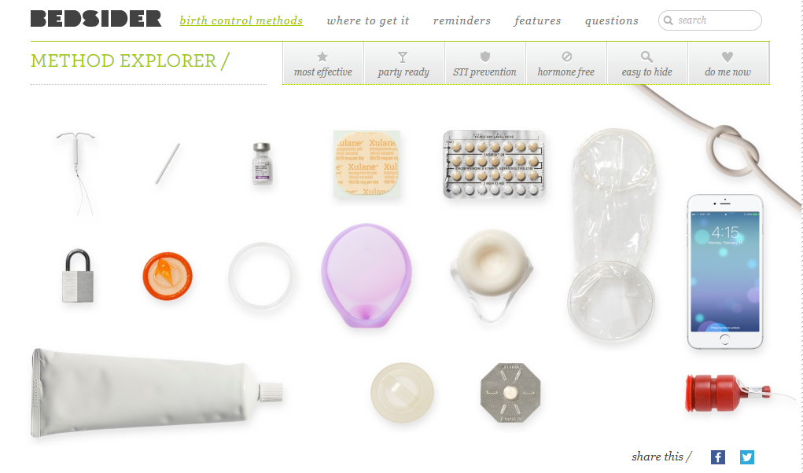
So Many Options…
How do you present them all?

Slide 19
We want to create a safe space by:
Listening
Not making assumptions
Elicit and address patient priorities

Slide 20
Listening means…
Silence
Asking open-ended questions
Acknowledging and affirming the patient’s unique experiences and beliefs
Notes:
So what does listening mean?
Well, it may seem obvious, we need to be silent and give the patient the space to ask questions and raise concerns.
When we ask questions, it is helpful to start with open-ended questions. This helps to create an environment where listening is more of a priority than getting answers. There are obviously some times when using closed-ended questions are really important—in order to help get focused and pointed information. But in terms of what constitutes listening, using open-ended questions can give us this space.
And when we allow the patient to share their own contraceptive beliefs (based on their own experiences and those of their trusted friends and family) we should approach these beliefs with humility and respect. While we need to know the current evidence about which side effects are proven, we must also remember that there is individual variance and the medical consensus is ever-changing. To maintain a space of mutual respect and trust, we may need to approach patient’s reluctance about methods with care, such as…
“That’s too bad your friend had that experience. I know that particular experience is unusual and if you were to use this method it would be unlikely to happen to you. But I understand you may be reluctant to use this method anyway, so lets consider some other options.”

Slide 21
Not assuming means…
Not taking for granted that you and the patient share the same feelings, beliefs, or understanding of medical terminology
ASK permission to provide information about other methods
You do not have The Answer, nor are you obligated to find it for the patient
Notes:
The second part of our approach is not assuming. So what does not assuming mean?
Well first, not assuming means that you don’t take for granted that you and the patient share the same understanding of medical terminology, feelings, or beliefs. We also don’t assume that patients know about all the different contraceptive options or understand how they work.
Try providing a context, such as “Some methods may change your period, or make it go away. Others will keep your period very predictable. Having your period change while using a birth control method is not a problem for your health, but is it something that might be important for your lifestyle?”
If a patient has expressed strong interest in one method, ASK first if they are interested in hearing about other methods.
And in not assuming, we take a step back from professional mode. And I know that this can be difficult, right? Because the way that we are taught is that—in medicine, in nursing, in social work, in psychology—we are supposed to have the answer - which is the “best” contraceptive. But, again, in this context, when guiding people through decision making, we actually don’t have the answer, nor are we obligated to find it out for the patient. Remember that they have the answer.

Slide 22
Eliciting and addressing the patient’s priorities and concerns means…
Ask about the patient’s preferences:
  Getting a period (or not)
  Hormones
  Easily Stopped
  Having something stay in your body
  Effectiveness
Notes:
An essential part of the contraceptive visit is to identify the patient’s priorities for contracepting. These may be related to side effects, or concerns about hormones. They may want to easily get pregnant or be fearful about things getting “left” inside them. These are all valid concerns and should be taken seriously. And while there may be opportunities to correct misinformation, these concerns may also help guide your discussion towards methods that the patient would find more acceptable.
-invisibility
-how different contraceptives affect sexual relationships

Slide 23
Do you need/want to get a regular period?
Notes:
How do you feel about having a period?
Many patients tell us that they think not having a period is not healthy or clean. They also worry that they might be pregnant if they miss a period, even if they are using a reliable contraceptive method such as an IUD. Teens are often worried that their mom will notice they missed a period and will ask them if they are having sex?
We know that missing a period is medically safe, but if a patient is uncomfortable with changes to her period she likely won’t want to start or continue using a method that alters her period. And if we try to minimize the potential menstrual changes of a particular method, we are doing that patient a disservice and undermining our rapport with that patient. So we should focus on the methods that do maintain a more regular, predictable period

Slide 24
How do you feel about hormones?
Notes:
How do they feel about hormones?
Many patients know about the testing of hormonal methods on women of color, (such as the pill trials in Puerto rico in the 1950s) and are mistrustful of a clinicians offering them a hormonal method. They may be concerned about side effects such as hair changes, skin changes, affect on libido or mood. Again, we know the hormones we use are safe, but if a patient is worried about the safety or side effects it may not be a method that would work for her over time.

Slide 25
Do you want to easily stop the birth control if you don’t like it?
Notes:
Can they stop method easily if they don’t like it?
Patients who choose condoms, pills-patch-ring, can stop the method on their own, and don’t need to come back to a clinician to do so. For most patients, stopping a LARC device requires a trip to the clinician. Depo will last for 3 months and cannot be quickly stopped. Return visits to an office can pose both a financial and time burden on most patients and they may be reluctant to commit to a method that requires this. They might also be worried that we will lecture them about stopping a method, especially if we had initially advocated for choosing it.
Being able to quickly stop a method at any time also gives patients a greater sense of autonomy and control over one’s body. This is particularly relevant in communities that have an continue to experience oppression and policing of their bodies.

Slide 26
Do you mind having something stay in your body?
Notes:
Do they want something in their body?
Some patients are worried about something being inside their body based on the stories about older devices such as the dalkon shield which had terrible risks of infection associated with it and the Norplant which was difficult to remove and caused pain and scarring.
There are also community concerns about the history of forced sterilization and reproductive coercion involving long-acting methods.

Slide 27
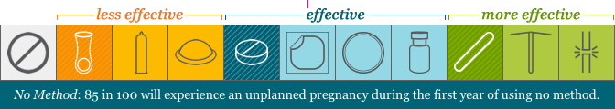
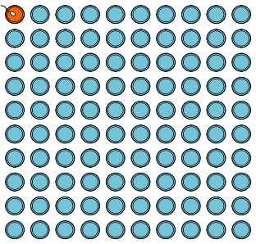
How well does this prevent pregnancy?
OCP effectiveness
IUD effectiveness
Notes:
How effective is it?
Some patients are worried about how well something will work (or how likely it will be to fail) so we need to explain effectiveness in ways that patients can easily understand and compare. Bedsider provides effectiveness charts like these that show pregnancy risk pictorially which may be easier to understand for some patients

Slide 28
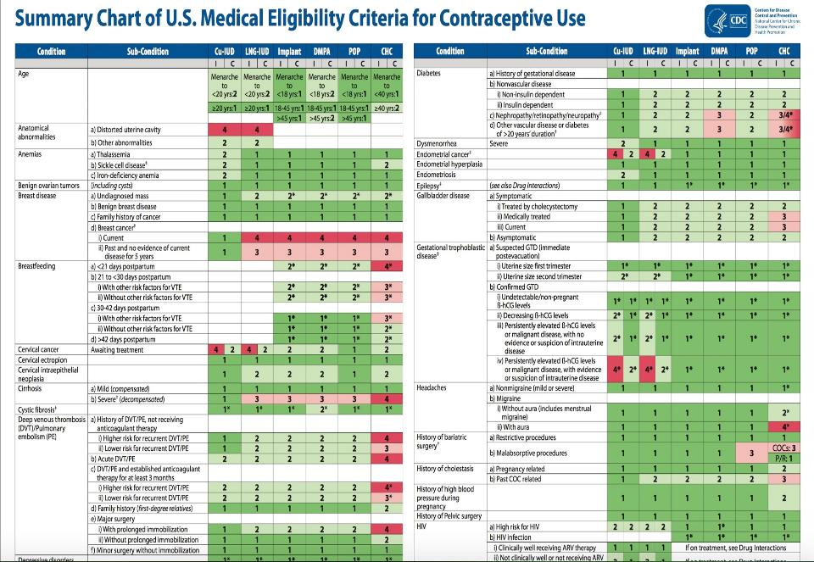
Notes:
Another way to frame options are to rule out any method that might be contraindicated for a particular patient
For example, migraine with aura

Slide 29
Case for discussion
A patient had her IUD inserted a few months ago in your clinic and returned with problems (pain, bleeding, headaches) and requested removal.
Your colleague says not to remove the device because she hasn’t tried anything to alleviate her symptoms.
What do you say to her?

Slide 30
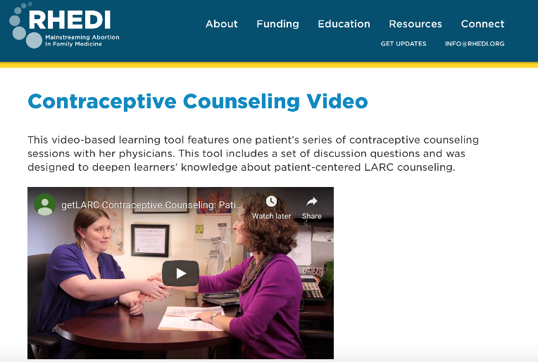
RHEDI resources
https://rhedi.org/education/contraceptive-care/

Slide 31

Discussion

